Slide 1
Introduction to Data Science Data Mining for Business Analytics
Brian d’Alessandro
VP – Data Science, Dstillery
Adjunct Professor, NYU
Fall 2014
Fine Print: these slides are, and always will be a work in progress. The material presented herein is original, inspired, or borrowed from others’ work. Where possible, attribution and acknowledgement will be made to content’s original source. Do not distribute, except for as needed as a pedagogical tool in the subject of Data Science.
Notes:
https://www.youtube.com/watch?v=aMDe5pODkB0 (harlan harris)

Slide 2
Decision trees
Notes:
The goal of finding structure is to information from one source to reduce uncertainty about another source.
What does this mean? Conditional distribution example. I.e., carnival guy who guesses your weight. If I can see your height I can reduce uncertainty about weight.
Find some height/weight data.
Under supervised exploration:
How can we (automatically) obtain a selection of the more informative variables with respect to predicting the value of the target variable?
Even better, can we obtain the ranking of the variables?
Can think of importance as one that makes the target variable more pure. This leads to the notion of entropy.

Slide 3
Targeted exploration
If we have a Target variable in our dataset, we often wish to:
Determine whether a variable contains important information about the target variable (in other words, does a given variable reduce the uncertainty about the target variable).
Obtain a selection of the variables that are best suited for predicting the target variables.
Rank each variable on its ability to predict the target variable.
Notes:
Do the demo as well

Slide 4
entropy
This comes from Information Theory, and is a measure of the unpredictability or uncertainty of information content.
Certainty => Closer to 0% or 100% sure that something will happen.
Entropy is fundamental concept used for Decision Trees and Feature Selection/Importance, and is a tool that can satisfy the demands stated on previous slide.
Notes:
Do the demo as well

Slide 5
entropy
More formally…
X is a random variable with {x1, x2 … xN} possible values, the entropy is the expected “information” of an event, where “information” is defined as –log(P(X)).
Equation source: http://en.wikipedia.org/wiki/Entropy_(information_theory)
Notes:
Do the demo as well

Slide 6
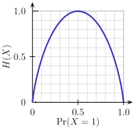

entropy
Example: Coin Flip, X is a random variable with possible values {H,T}
Entropy of a coin: - [P(H)*log2(P(H)) + P(T)*log2(P(T))]
Fair Coin:
H(X)=-[0.5*Log2(0.5)+0.5*Log2(0.5)] = 1
Single Outcome Coin:
H(X)=-[1*Log2(1)] = 0
Weighted Coin (P(H)=0.2):
H(X)=-[0.2*Log2(0.2)+0.8*Log2(0.8)] = .72
Image source: http://en.wikipedia.org/wiki/Entropy_(information_theory)
Notes:
Do the demo as well

Slide 7

conditional entropy
We want to explore whether the attributes head and body colors give us more information about our target variable (yes/no).
Yes
Yes
Yes
Yes
No
No
We use the Conditional Entropy
Where,
Y is binary target variable
X is the attribute
x is a value of an attribute
p(x) is the likelihood X=x
H(Y|X=x) is the entropy of Y where X=x
No
No
No
Yes
No
No
Notes:
Do the demo as well

Slide 8
Example cond. entropy
To compute conditional entropy of an attribute:
Compute P(X_{i}), P(Y|X_{i}), H(Y|X_{i}) for each attribute value X_{i}:
Attribute | Value | P(Xi) | P(Y|Xi) | H(Y|Xi)
Body | Red | 0.5 | 33% | 0.92
Body | Blue | 0.5 | 67% | 0.92
Head | Red | 0.5 | 83% | 0.65
Head | Blue | 0.5 | 17% | 0.65
Now apply the Conditional Entropy formula to the given attributes:
H(Y|Body) = 0.5*0.92 + 0.5*0.92 = 0.92
H(Y|Head) = 0.5*0.83 + 0.5*0.17 = 0.65
Notes:
Do the demo as well

Slide 9
Information gain
The Information Gain of an attribute measures the change in conditional entropy if we split the data by a given attribute.
where
Information Gain tells us how pure can we make segments with respect to the target variable if we split the population by a certain attribute.
Parent
H(Y)
Each child node c is the result of splitting the data by the values of a certain attribute, and has its own associated Entropy H(Y|c) as well as a split proportion p(c).
…
Child 1
H(Y|C₁)
Child 2
H(Y|C₂)
Child k
H(Y|C_{k})
p(c₁)
p(c₂)
p(c_{k})
Notes:
Do the demo as well

Slide 10
Using Information gain
With Information Gain we can now define a way to compare features on their ability to segment the data in a way that reduces the uncertainty of our target variable.
H(Y)=1.0
H(Y)=1.0
Head Color
Body Color
H(Y|H=r)=0.65
P(H=r)=0.5
H(Y|H=b)=0.65
P(H=b)=0.5
H(Y|B=r)=0.92
P(B=r)=0.5
H(Y|B=b)=0.92
P(B=b)=0.5
IG(Head)=1-(0.5*0.65+0.5*0.65)=0.35
IG(Body)=1-(0.5*0.92+0.5*0.92)=0.08
We get a higher IG when splitting on Head
Notes:
Do the demo as well

Slide 11
recap
With Entropy, Conditional Entropy and Information gain, we now have tools that can help us:
Quantify the purity of a segment with respect to a Target variable
Measure and rank individual features by their ability to split the data in a way that reduces uncertainty about the target variable.
Next we’ll use these tools to build a classifier
Notes:
Do the demo as well

Slide 12
C4.5 – towards a decision tree
Several algorithms exist that return a decision tree structure, but we’ll focus on C4.5, which utilizes the information theoretic tools learned so far.
Given a dataset D=<X,Y>, where Y is a target variable and X=<X₁,X₂,..X_{k}> is a k-dimensional vector of predictor variables.
C4.5 pseudocode
1. For each feature x_{i} in X:
Compute split that produces highest Information Gain
Record Information Gain
2. Let X^{max} be the feature with the highest Information Gain
3. Create child nodes that split on the optimal splitting of X^{max}
4. Recurse on each child node from step 3 on the remaining features.
Notes:
Do the demo as well

Slide 13
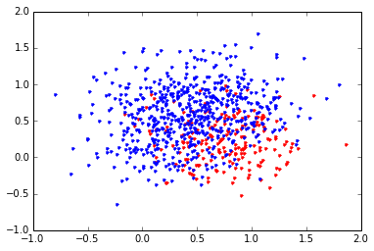
Lets build a tree
We have data generated as a mixture of 4 different bivariate distributions with means: mu=[[0.25,0.75],[0.75,0.75],[0.75,0.25],[0.25,0.25]], and all with the same covariance structure.
The distribution with mean [0.75,0.25] was given a ‘red’ label.
Notes:
Do the demo as well

Slide 14
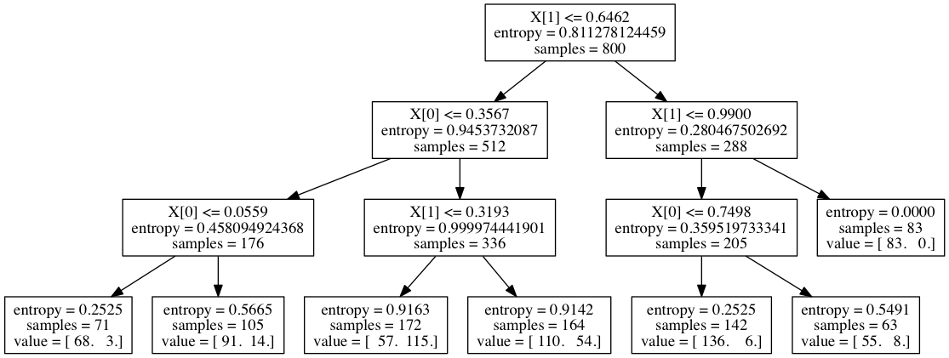
Trees with sci-kit learn
from sklearn.tree import DecisionTreeClassifier
clf = tree.DecisionTreeClassifier(args)
clf = clf.fit(X,y)
Note: with a lot of features and a lot of data, trees can be incredibly large. Its not always worth it to try and visualize them.
Notes:
Do the demo as well

Slide 15
Understanding the tree
Each parent node references the feature chosen by the splitting algorithm.
The node specifies a boolean condition
If True, then move to the right
Else move to the left
The final child nodes (leaves) show the distribution of the target variable at that node
The prediction by averaging the target variable at each leaf.
Notes:
Do the demo as well

Slide 16
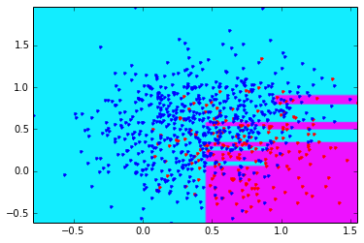
Partitioning X space
We can think of the Decision Tree as a rectangular partitioning of the feature space. Again, this is done with a series of boolean conditionals.
For classification tasks, the partition determines the predicted class. This chart shows the decision boundries with the training data overlayed.
Notes:
Do the demo as well

Slide 17
Controlling complexity
Like any classifier, when the ratio of features to data points shrinks, we risk overfitting.
Three parameters for controlling tree complexity are to limit the depth of the tree limit the size of an internal node that can be split, and to specify the minimum number of instances that can be in a leaf.
Depth of tree measures how many layers of splits there can be.
Min split size limits how big an internal node can be to allow for splitting.
Min leaf size makes sure each final leaf has sufficient data.
Notes:
Do the demo as well

Slide 18
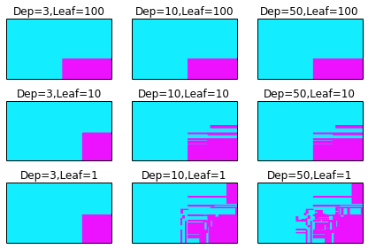
Controlling complexity
Visualizing more complex trees is difficult, but we can see how the decision boundary changes once we let trees grow arbitrarily complex. Overfitting is likely if we don’t set any limits on the complexity.
Notes:
Do the demo as well

Slide 19
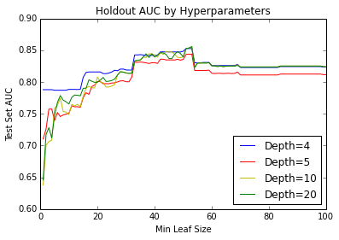
Learning optimal tree size
We built a DT for the “Ads” dataset presented in HW. In this case we have unbalanced class distribution so we choose Area Under ROC curve as our evaluation metric*
This region is safe, but clearly not optimal.
For most depths, we overfit when the leaves get too small
Note: We haven’t taught this yet, but suffice it to say that AUC is better than accuracy when the classes are skewed.
Notes:
Do the demo as well

Slide 20
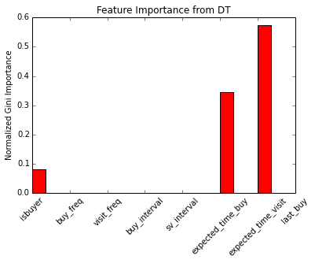
feature exploration
Often times the DT is useful as tool for testing for feature interactions as well as ranking features by their ability to predict the target variable. Scikit learn’s DecisionTree fit function automatically returns normalized information gain for each feature (also called the Gini Importance)
Notes:
Do the demo as well

Slide 21
Decision trees in practice
Advantages
Easy to interpret (though cumbersome to visualize)
Easy to implement – just a series of if-then rules
Prediction/scoring is cheap – total operations=depth of tree
No feature engineering necessary
Can handle categorical/text features as is
Automatically detect non-linearities and interactions
Note: We haven’t taught this yet, but suffice it to say that AUC is better than accuracy when the classes are skewed.
Notes:
Do the demo as well

Slide 22
Decision trees in practice
Disadvantages/Issues
Easy to overfit – flexibility of algorithm requires careful tuning of parameters and leaf pruning
DT algorithms are greedy – not very stable and small changes in data can give very different solutions
Difficulty learning in skewed target distributions (think of how entropy might cause this).
Not well suited for problems as # of samples shrinks and # of features grows
Note: We haven’t taught this yet, but suffice it to say that AUC is better than accuracy when the classes are skewed.
Notes:
Do the demo as well

